Slide 1

DALEBRO Sourcing Distribution & Consulting
www.dalebro.com

Slide 2
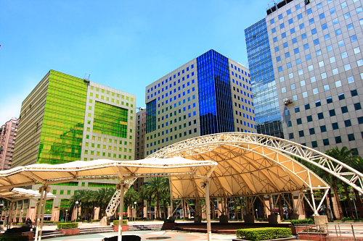

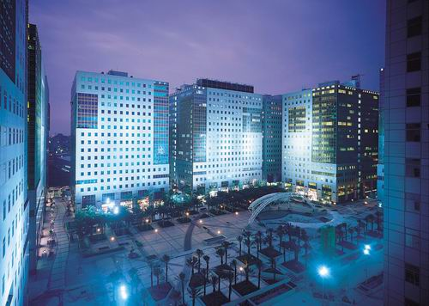
COMPANY PROFILE
About us
DALEBRO WORLDWIDE LIMITED is a Taiwanese company specialized in sourcing services, distribution of products from different industries and consulting services for the Latin American market. We focus particularly on this area due to the huge potential and existing growth. With more than 10 years of experience and with a trained professional team, we also provide consulting services for the development of new business or establishment of industrial factories.
Vision & mission
Our vision is to become the customer’s eyes and hands in Asia, minimizing their risks and maximizing their profits. We seek to consolidate as a leader par excellence, always providing value-added services at each stage of work.
Photo: Business Complex where Dalebro office in Taipei is located.
OUR OFFICES
Since we first started operations in 2003, we have strategically opened offices in Asia and Latin America:
TAIPEI OFFICE HEADQUARTER
MIAMI OFFICE
GUANGZHOU OFFICE
The headquarter established in Taipei, has a consultant team, financial team and logistic team.
Staying closer to our customers to provide an immediate response.
For managing the relationship with suppliers and quality control of products.
www.dalebro.com

Slide 3
WHY CHOOSE DALEBRO
有型的資源
無形的優勢
位於各洲的辦公室
高度的機動性
及快速的回覆
優勢
精通西班牙文,中文
及英文
溝通無障礙
- 高績效
- 經濟效益增加
- 在競爭中領先一步
充足的人力資源,
資料及知識
提供附加價值
的服務
- 降低成本
- 簡化操作
- 減少時間和延誤風險
各領域經驗充足的專業人士
有效的執行策略
及流程
風險
www.dalebro.com

Slide 4


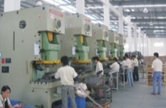
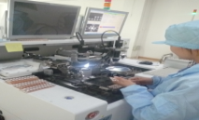
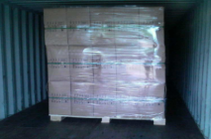

VALUE CHAIN
工廠分析
市場調查、工廠及產品的搜尋及審核
Our value
In each link of the chain of work you can appreciate Dalebro value-added services that we offer to ours customers. We coordinate and supervise in detail all process and operations in the supply chain:
規劃
規劃及定義產品規格、品質標準、採購價格及條件
生產
外包生產、物料確認、交期
品質管控
監督生產流程(SOP)、管控及品質標準制定
物流
協調處理物流及相關文件準備
售後服務
.
持續提供RMA協助及諮詢
www.dalebro.com

Slide 5
SERVICE - SOURCING
Dalebro – LEADER in SOURCING SERVICES
China has become the manufacturing center of the world, with thousands of factories producing a wide variety of consumer products. Dalebro gives support to companies for handling international procurement especially in Asia. As your sourcing agent we not only take care of finding the product with the desired quality but also the verification of reliable manufacturers in order to establish a long term business relationship between manufacturer and customer.
CIRCLE OF BENEFITS
Production Control
Inspection and quality control
Prices and purchasing terms negotiations
One Stop Shop
Logistics Services
DALEBRO
Search of factories and product services
Other value-added services
CUSTOMER
One Stop Shop
We reduce operations by being a “ONE STOP SHOP” offering several services in one place.
Your office in Asia
We are your contact point in Asia, minimizing your infrastructure cost and personnel.
Team work
Customer is responsible for sales in local market, Dalebro is responsible for the operational management in Asia checking that customer’s orders meets their expectations.
www.dalebro.com
www.dalebro.com
www.dalebro.com

Slide 6




SERVICE – DISTRIBUTION
Dalebro – Excellent distributor
We are leading distributor of products manufactured in China for Latin America. Over the years we have acquired a portfolio of brands and products with trusted vendors offering good quality and competitive costs. We have the knowledge to handle the purchase process, supply chain as well as local export regulations making the job easier for our customers.
We have a porfolio of validated products where the most outstanding are:
We offer customer their own brand and in all kind of forms:
Productos de Energía Limpia y Renovable
OEM & ODM:
- Marca del Cliente
- Marca Genéricas
產品形式:
CBU: 成品
SKD: 半成品
- CKD:
Otros
Productos en Formatos:
- CBU: Complete Built Unit
- SKD: Semi-Knocked Down
- CKD: Complete-Knocked Down
Línea Blanca y Hogar
Productos de Electrónica de Consumo
www.dalebro.com

Slide 7
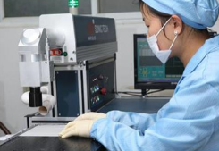
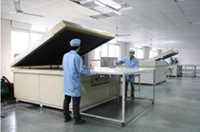
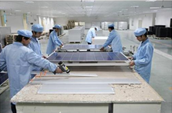
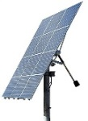
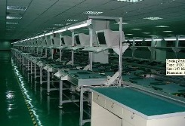
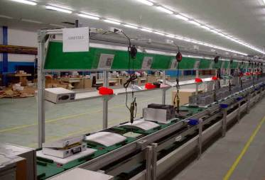
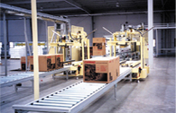

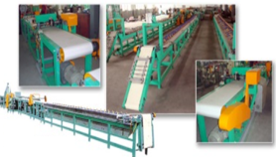
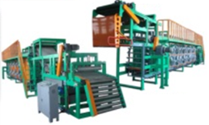
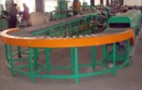
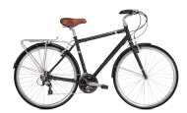
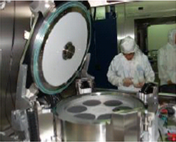

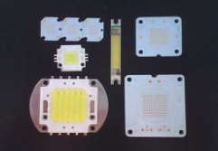
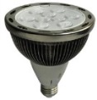
SERVICE – CONSULTING
Dalebro – turnkey solutions specialist
"Turnkey Solutions" - are engineering projects that can be designed, produced and adjusted to fit customers requirements so it can be used immediately after the delivery. Through the years, Dalebro has accumulated the knowledge, experience and resources in different areas to provide consulting services to our customers in the implementation of new technologies and production methods in their countries. We assist our customers with the transfer of knowledge, the "know-how" to enable production in the shortest time possible and more efficiently.
Successful cases implemented by Dalebro:
Assembly line for PC & notebooks in Mexico
Production line for bicycle inner tube in Argentina
Production line for solar panels in Argentina
Production line for LED lights in Brazil
=
=
=
=
www.dalebro.com

Slide 8
CONTACT US
Dalebro – Taiwan (Headquarter)
3F., No. 16, Jian 8th Rd., Zhonghe District, 235, New Taipei City, Taiwan Tel: +886-2-82263818 Fax: +886-2-82263819 Email: info@dalebro.com
Dalebro – China
No. 2, 7FL, Zhukeng Village, Panyu District, Guangzhou, Postcode: 511400, Guangdong, China Tel: +86-20-22871559 Fax: +86-20-22871663 Email: info@dalebro.com
Dalebro – Latin America
9555 SW 181st Terrace, Miami, FL33157, USA
Tel: +1-786-4448632
Email: info@dalebro.com
www.dalebro.com

